Slide 1
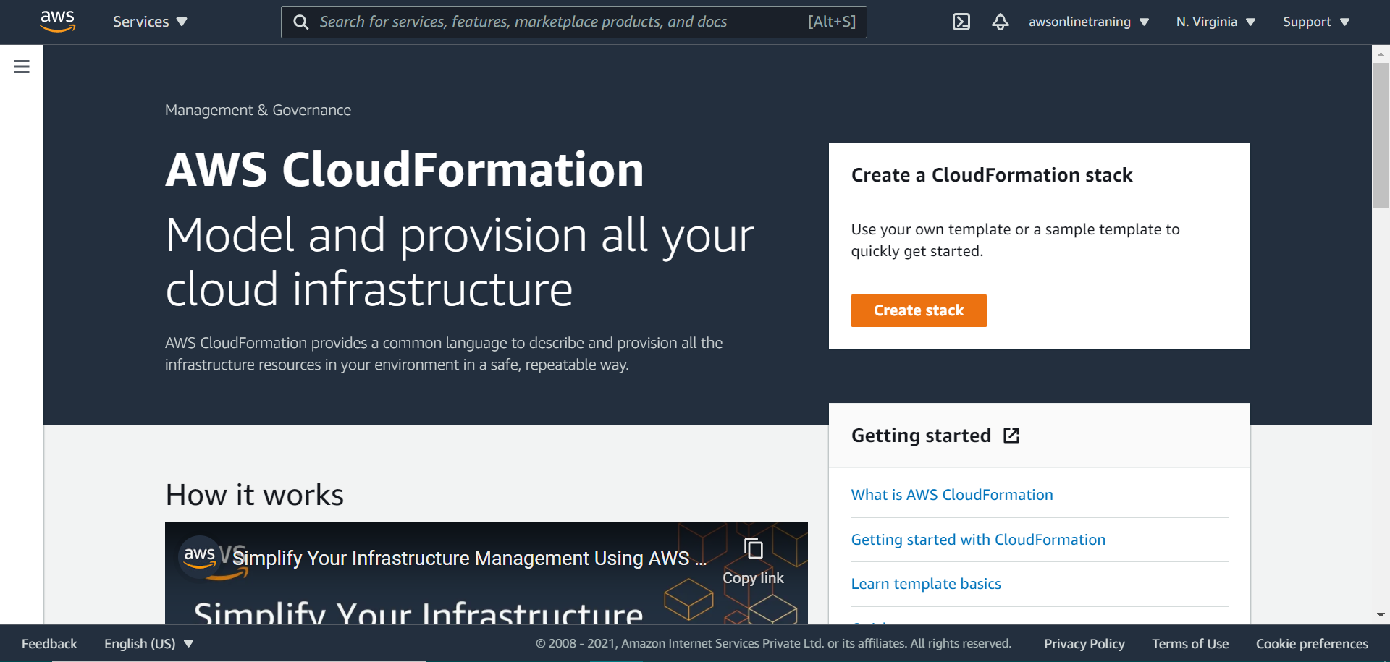

Slide 2
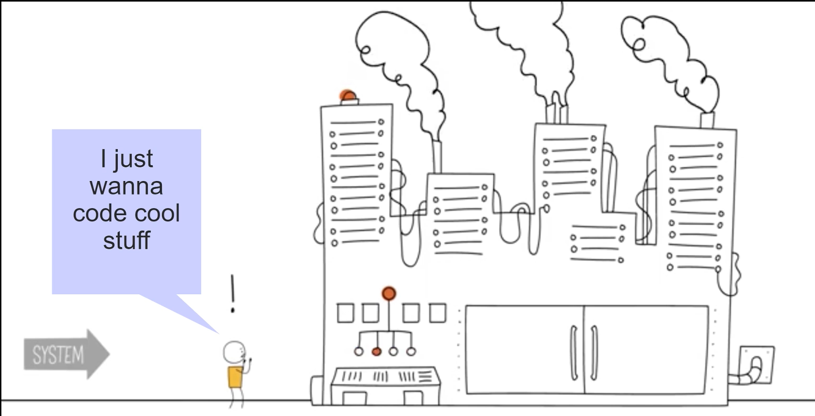

Slide 3
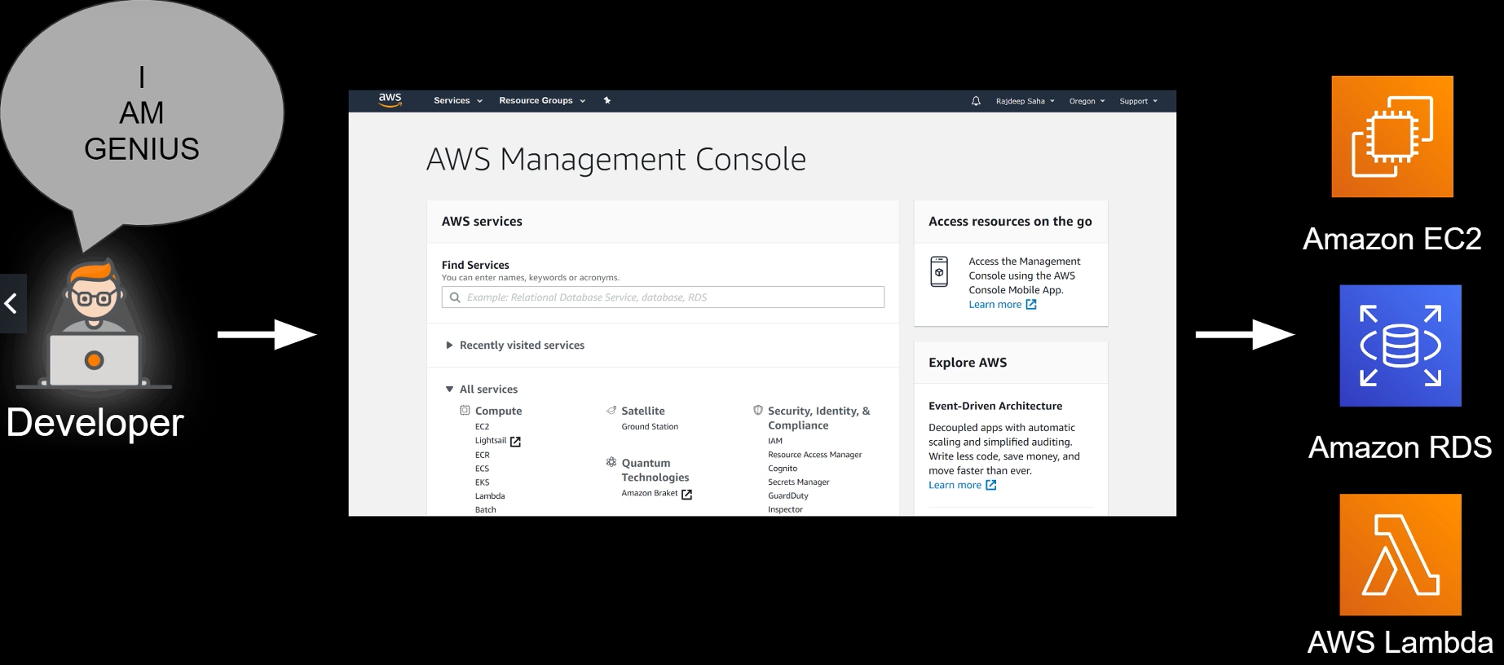

Slide 4
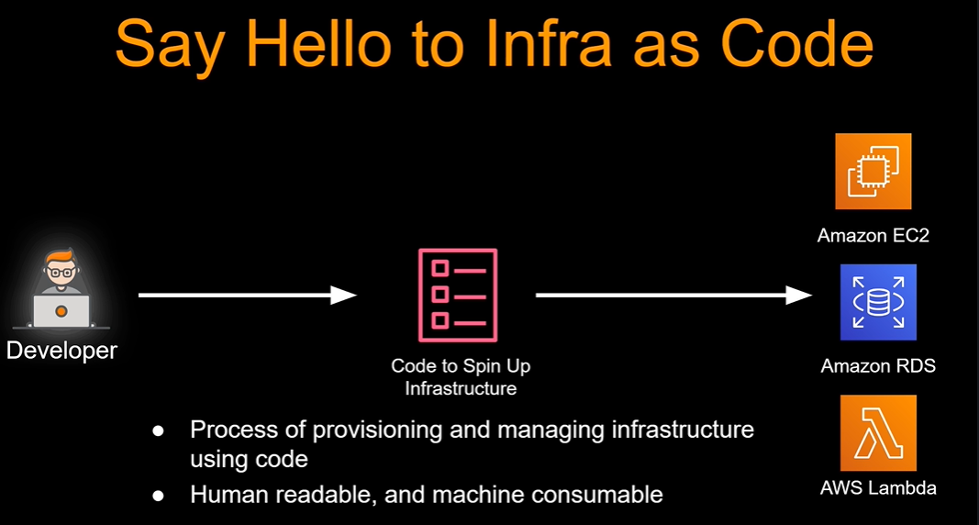

Slide 5
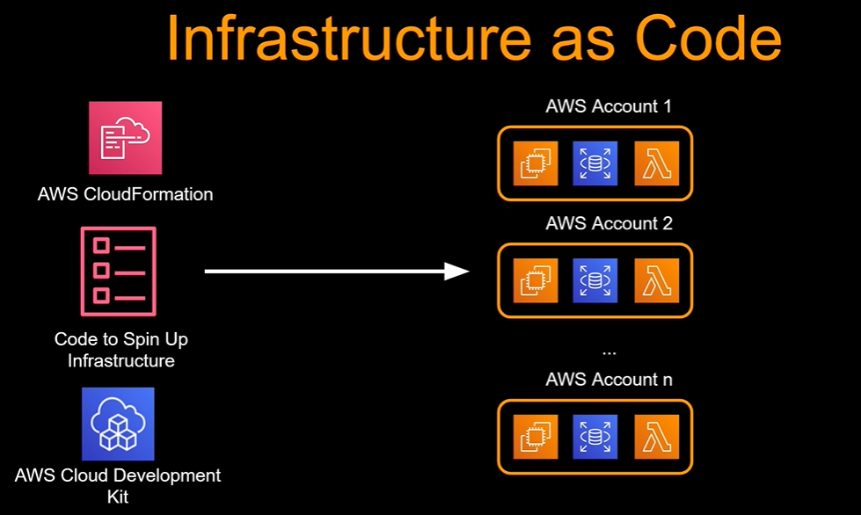

Slide 6
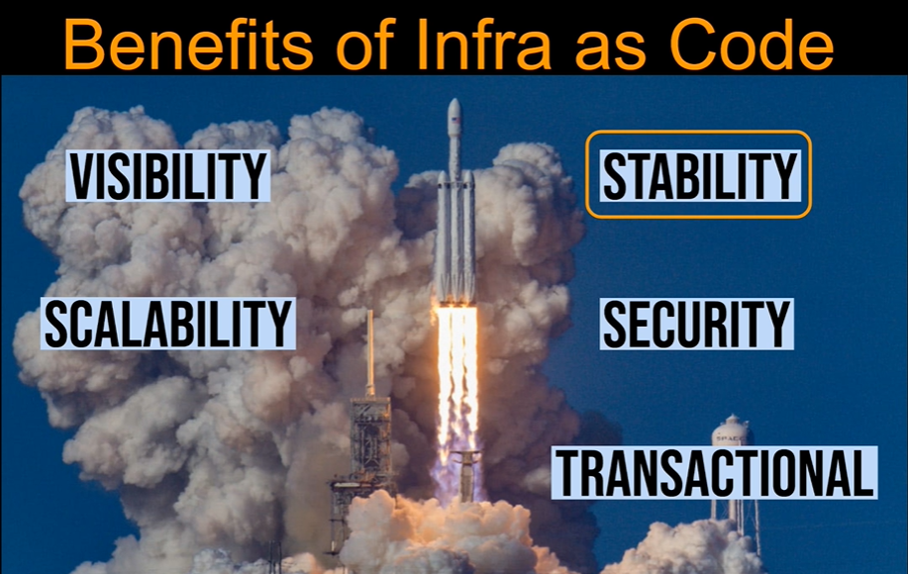

Slide 7
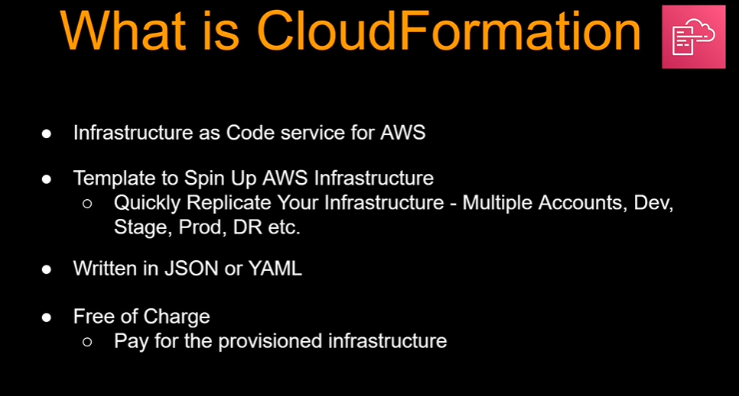

Slide 8
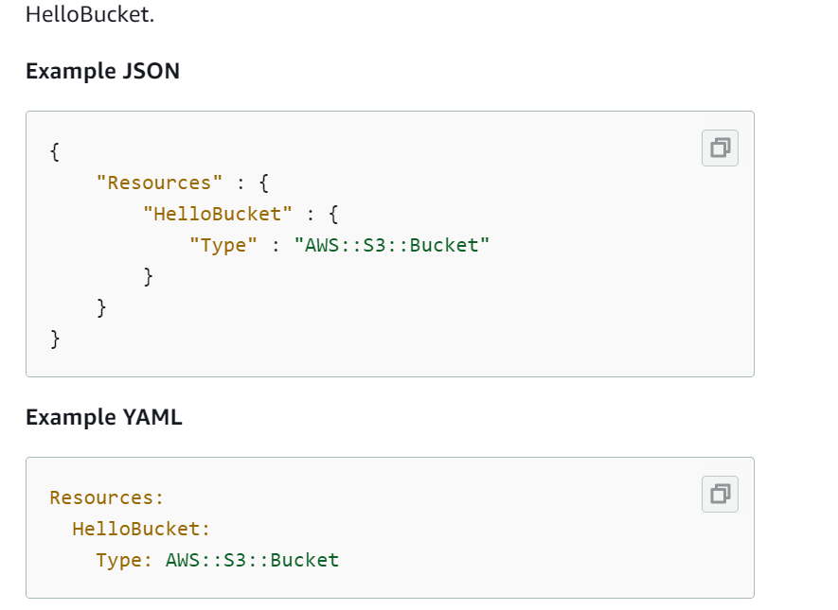
Notes:
https://docs.aws.amazon.com/AWSCloudFormation/latest/UserGuide/gettingstarted.templatebasics.html

Slide 9
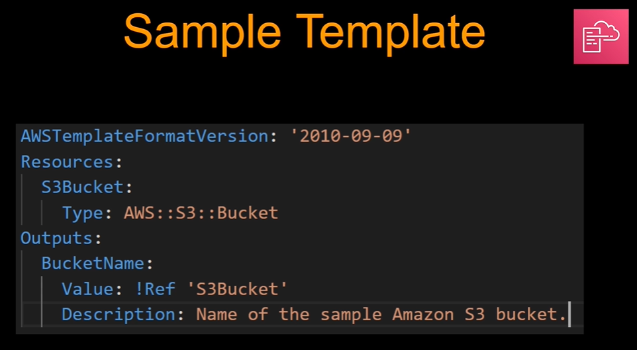
Notes:
https://docs.aws.amazon.com/AWSCloudFormation/latest/UserGuide/gettingstarted.templatebasics.html

Slide 10
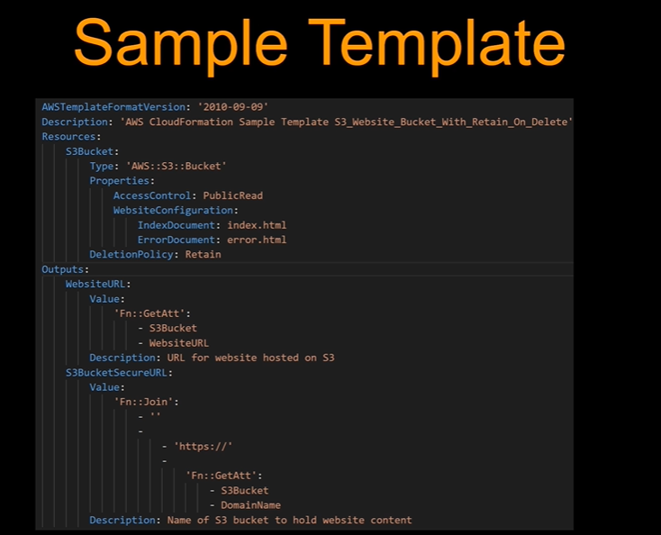

Slide 11
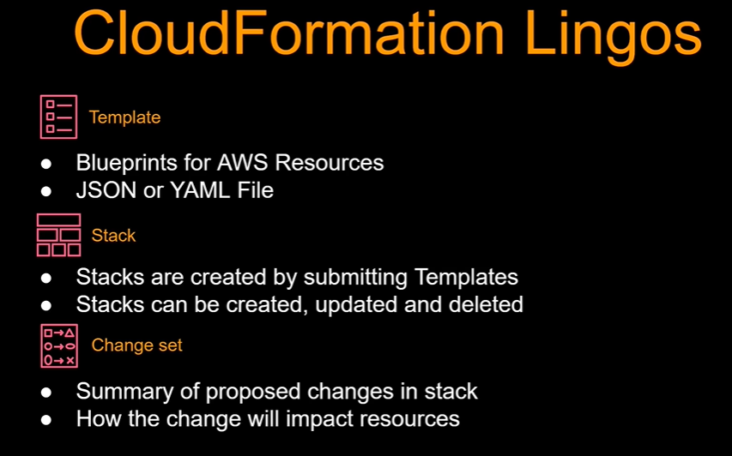

Slide 12
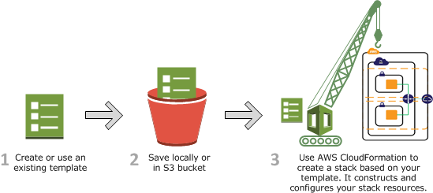
https://docs.aws.amazon.com/AWSCloudFormation/latest/UserGuide/cfn-whatis-howdoesitwork.html
Notes:
https://docs.aws.amazon.com/AWSCloudFormation/latest/UserGuide/cfn-whatis-howdoesitwork.html

Slide 13
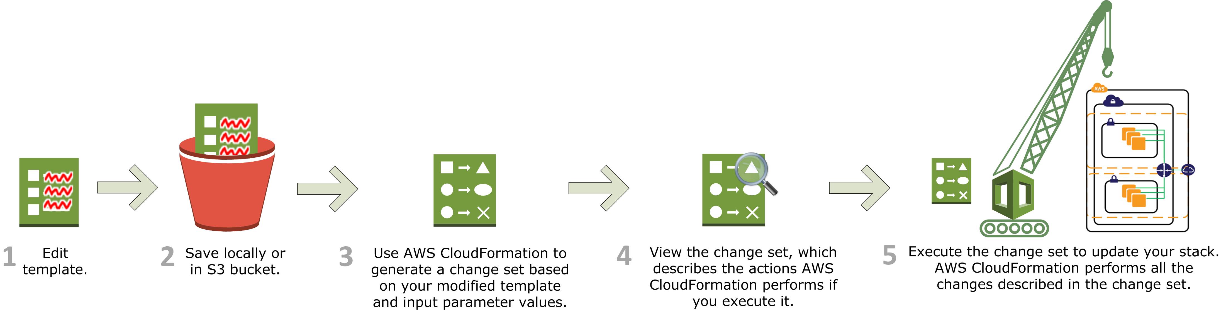
https://docs.aws.amazon.com/AWSCloudFormation/latest/UserGuide/cfn-whatis-howdoesitwork.html
Notes:
https://docs.aws.amazon.com/AWSCloudFormation/latest/UserGuide/cfn-whatis-howdoesitwork.html

Slide 14
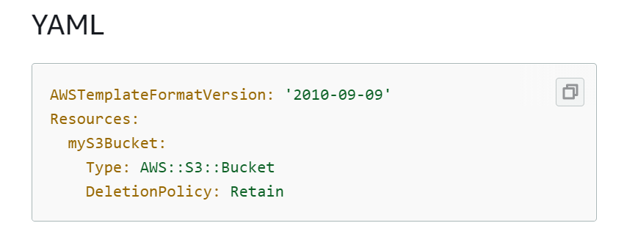

Slide 15

https://docs.aws.amazon.com/AWSCloudFormation/latest/UserGuide/sample-templates-services-us-east-1.html#w2ab1c35c52c13c15
Notes:
https://docs.aws.amazon.com/AWSCloudFormation/latest/UserGuide/sample-templates-services-us-east-1.html#w2ab1c35c52c13c15

Slide 16
C:\AWS-DevOPS\Traning-Vendors\Integrated Solutions\AWS Developer\Final\CDK-CloudFormation\Resources\01_CloudFormation\ec2-with-userdata.yml
Notes:
C:\AWS-DevOPS\Traning-Vendors\Integrated Solutions\AWS Developer\Final\CDK-CloudFormation\Resources\01_CloudFormation\ec2-with-userdata.yml

